Slide 1

Time is my capital, not money.
Software Engineering and Professional Practice
2016/2017

Slide 2
Index
What is Metronus?
Our team
Technologies
A closer look
Business plan
Lessons learnt

Slide 3
Index
What is Metronus?
Our team
Technologies
A closer look
Business plan
Lessons learnt

Slide 4


Slide 5
Index
What is Metronus?
Our team
Technologies
A closer look
SWOT analysis
Marketing plan
Lessons learnt

Slide 6




Our team
José Renato Ramos
José Gavilán
Front-end coordinator
Front-end developer
Front-end developer
Andrés Jiménez
Juan Carlos Liébana
Front-end developer
Front-end developer

Slide 7





Our team
Agustín Borrego
Andrés Doncel
José María Jiménez
Back-end coordinator
Back-end Developer
Back-end developer
Back-end developer
Álvaro González
José Antonio Rojo
Back-end developer
Back-end developer

Slide 8
Index
What is Metronus?
Our team
Technologies
A closer look
SWOT analysis
Marketing plan
Lessons learnt

Slide 9






Technologies

Slide 10
Index
What is Metronus?
Our team
Technologies
A closer look
Business plan
Lessons learnt

Slide 11
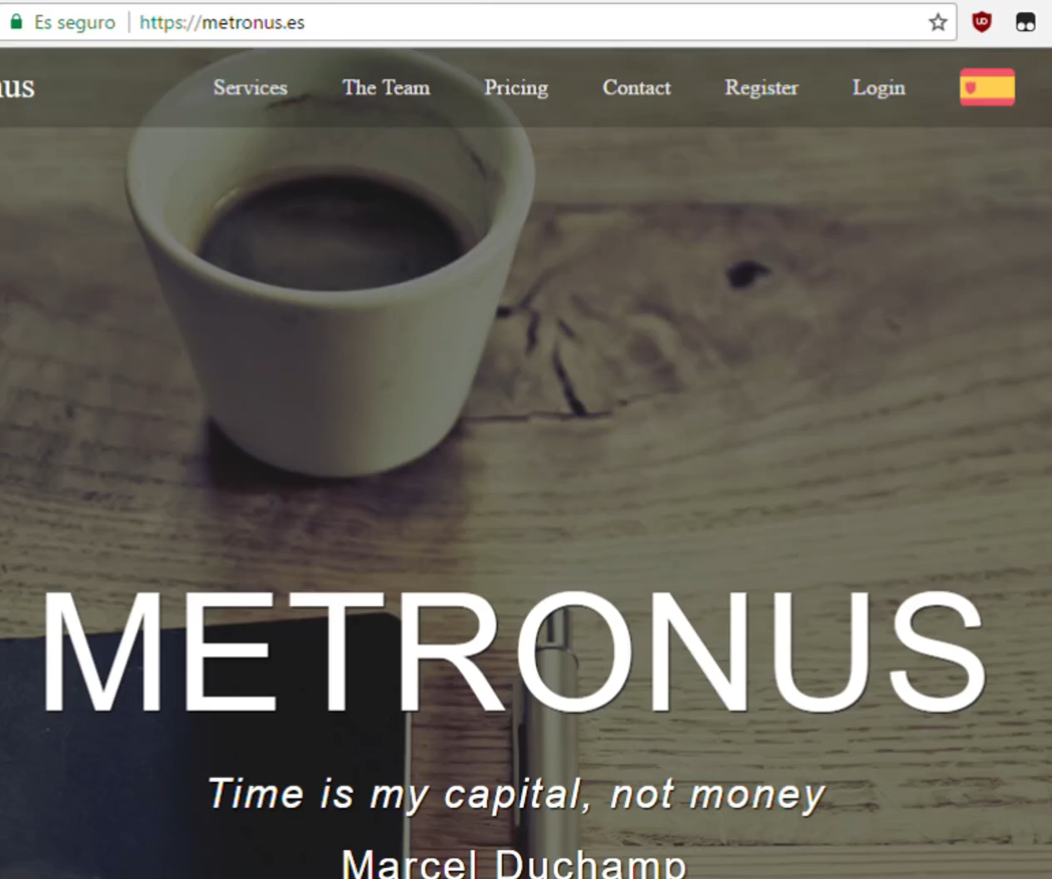
A closer look

Slide 12


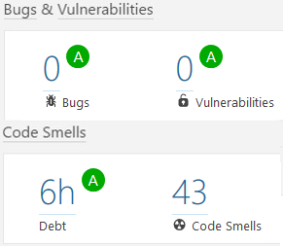



A closer look
Performance matters, too!

Slide 13
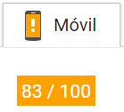
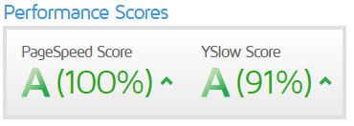
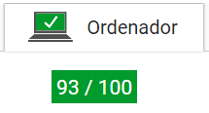
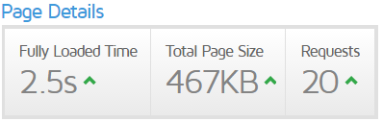
A closer look
Google InSights
GTMetrix

Slide 14
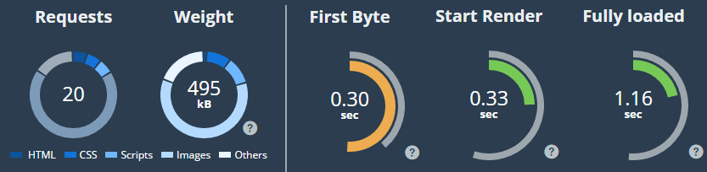
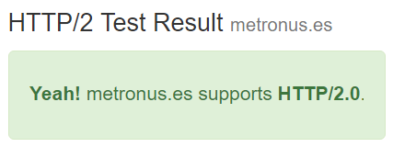
A closer look
Dareboost
KeyCDN Test for HTTP/2.0

Slide 15
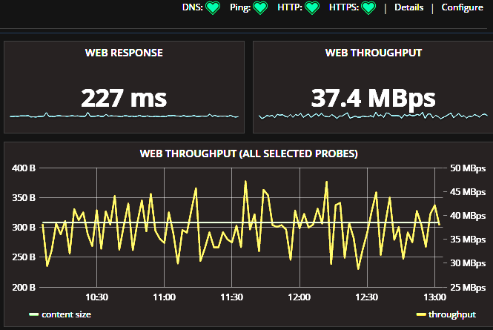
A closer look
Grafana at stats.metronus.es

Slide 16
Index
What is Metronus?
Our team
Technologies
A closer look
Business plan
Lessons learnt

Slide 17
Business plan
Strengths
Weaknesses
Opportunities
Threats

Slide 18


Business plan
Strengths
Never ending
solution
Django. Python. Security.
Best Friends Forever

Slide 19


Business plan
Strengths
Big team
Pressure is just a
measurement
Metronus is standalone

Slide 20


Business plan
Weaknesses
Lack of economic
resources
Team’s first
professional project

Slide 21
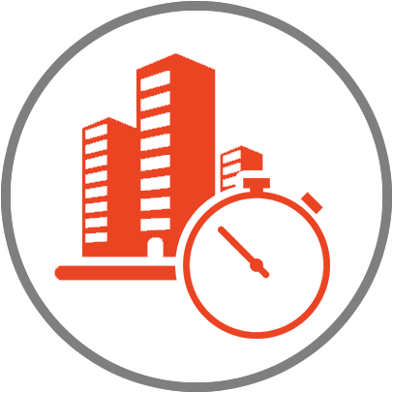

Business plan
Weaknesses
Big companies already have
their own Metronus
Fitting to Metronus
may be disruptive

Slide 22


Business plan
Opportunities
New companies
every day
Metronus works
everywhere

Slide 23


Business plan
Opportunities
Metronus fits to
your company
Mobile-first service

Slide 24


Business plan
Threats
Financial crisis
Data leakage

Slide 25


Business plan
Threats
New players in the game
Team disbanding

Slide 26

Business plan

Slide 27
Business plan
Return of Investment

Slide 28
Business plan
Budget
Direct costs: € 24,904,47
Indirect costs: € 9,274.14
Taxes: € 4,384.06
Contingency plan: € 4,537.57 (20%)
Total: € 43,104.94

Slide 29
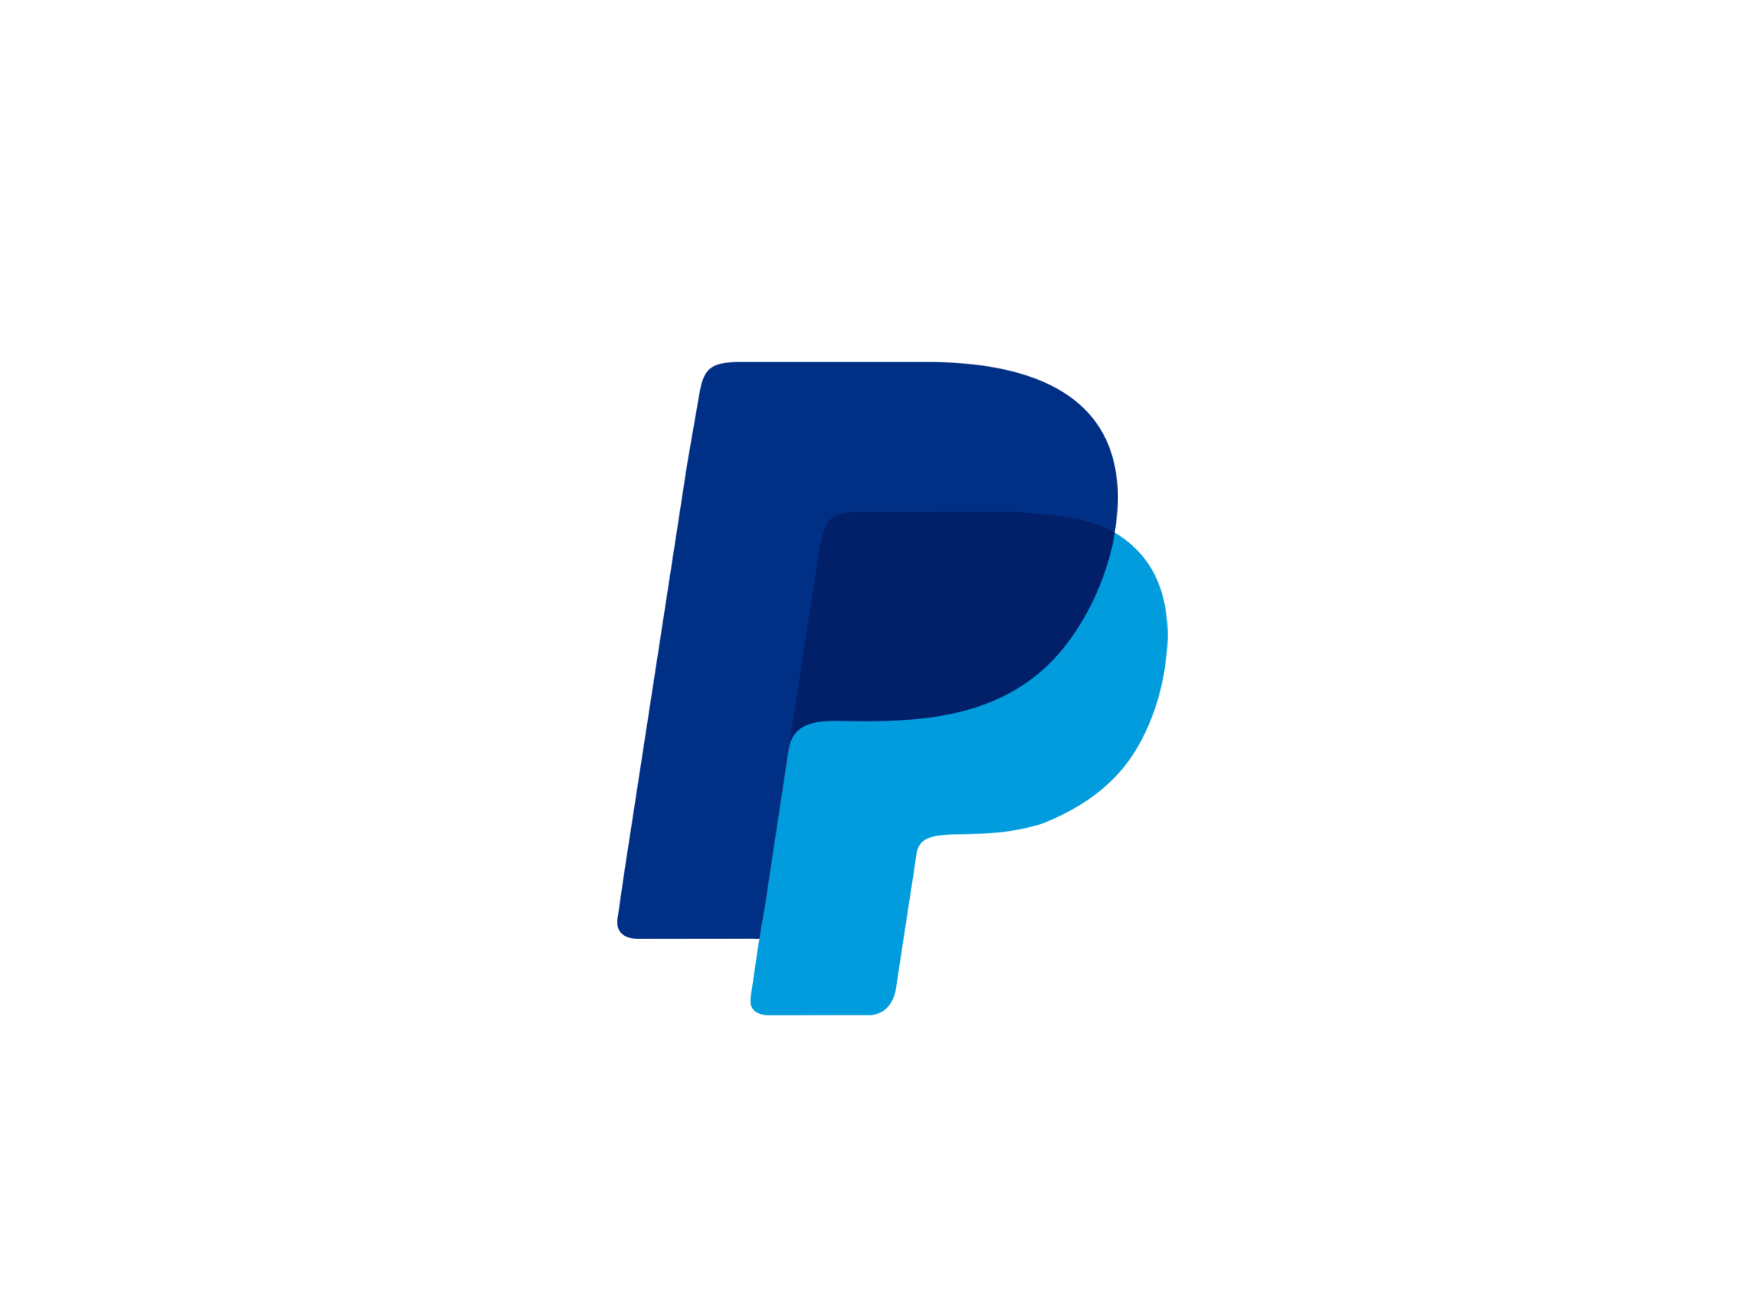
Business plan
Cost of the service
3 € per employee and tier
VAT 21%
0,35 € per transaction
3,40% per transaction

Slide 30
Business plan
1-5 employees
FREE!

Slide 31


Business plan
Which are our magical numbers?
0,48%
0,16%

Slide 32
Business plan
Optimistic case

Slide 33
Business plan
Pessimistic case

Slide 34



Business plan
What we have already done
Time control
Productivity Analytics
Profit Analytics

Slide 35


Business plan
Mid-term planning
Paysheets generation
Absences and vacations control

Slide 36


Business plan
Long-term planning
ETL
(Extract, Transform and Load)
Prediction models

Slide 37



Business plan
Long-term planning
Give some talks regarding usage of time
Hire new people
Open some offices

Slide 38
Index
What is Metronus?
Our team
Technologies
A closer look
Business plan
Lessons learnt

Slide 39
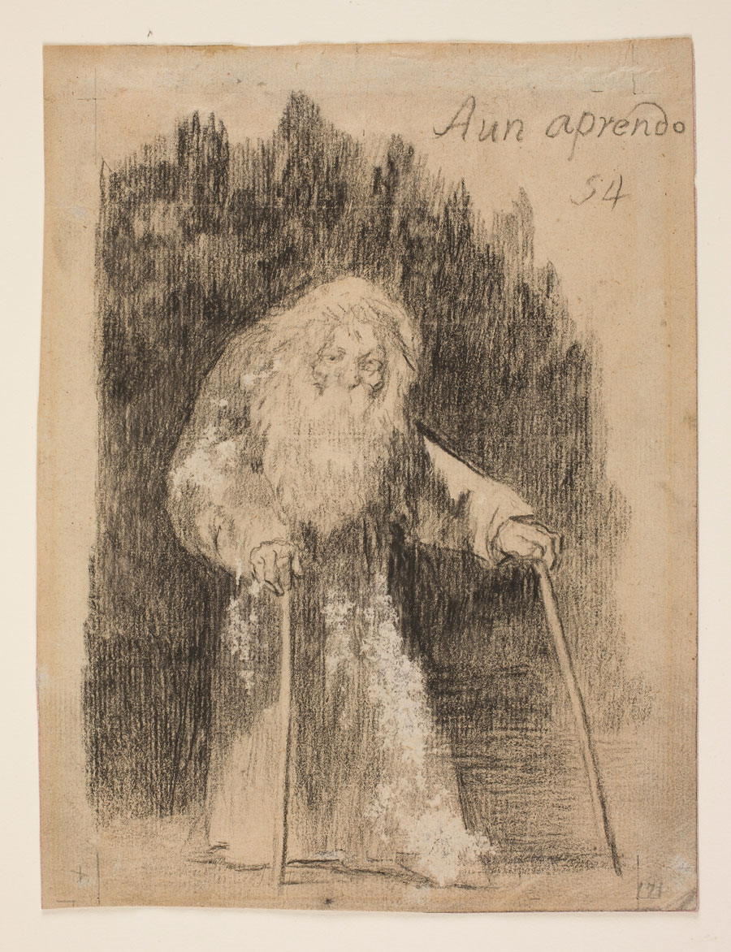
Lessons learnt

Slide 40


Lessons learnt
Big team
Don’t underestimate
your PM

Slide 41


Lessons learnt
Measure
Coding standards and documentation

Slide 42


Lessons learnt
Handle feedback
The grade is worth it

Slide 43



Thank you!
info@metronus.es
www.metronus.es
stats.metronus.es

